Slide 1




Briefing Session on
Made in Bangladesh Expo 2025
15-18 June 2025, Expo Center Norte, Sao Paulo, Brazil
BRAZIL BANGLADESH CHAMBER OF COMMERCE & INDUSTRY (BBCCI)
Presented by:
Md. Joynal Abdin, Secretary General

Slide 2

INTRODUCTION
The Made in Bangladesh Expo 2025 is a premier international trade fair showcasing Bangladesh’s industrial strength, innovation, and export-ready products. It aims to connect local manufacturers with global buyers, investors, and business partners. The expo highlights Bangladesh's growing role in the global supply chain across diverse sectors.

Slide 3




TRADE FAIR / EXPO
Programme Details
How to
How to Participate in an International Trade Expo Successfully
Programme Flow of the Made in Bangladesh Expo 2025, 15-18 June 2025

Slide 4

WHY COMPANIES PARTICIPATE IN TRADE EXPOS?
  Meet new buyers & distributors
  Launch new products
  Brand exposure
  Market research
  Build partnerships
  Generate leads

Slide 5
STEP 1 – INITIAL PREPARATIONS
Prepare or update:
      Company Profile
      Product Catalog
      Website
      Flyers & Brochures
      Business Cards

Slide 6




STEP 2 – DETERMINE PRODUCTS TO DISPLAY OR SELL?
Focus on unique/high-demand items
Select best-performing products
Ensure regulatory compliance

Slide 7



STEP 3 – TARGETED LEAD GENERATION
Use databases, LinkedIn, B2B platforms
Identify importers & buyers
Build contact list

Slide 8





STEP 4 – COMMUNICATE WITH LEADS BEFORE THE EXPO
ACTION 01
ACTION 03
Send invitations
Share booth details
ACTION 02
ACTION 04
Arrange B2B meetings
Provide booking calendar

Slide 9
STEP 5 – PREPARE PRODUCT SAMPLES
Export-grade packaging
Display-ready, functional samples
Proper labeling

Slide 10
STEP 6 – STALL DESIGN & DISPLAY STRATEGY
ACTION 01
ACTION 03
Attractive, professional setup
Clear display with tags
ACTION 02
ACTION 04
Posters, videos, banners
Meeting space

Slide 11
STEP 7 – SET YOUR EXPORT PRICING
Offer trade terms
Determine FOB, CIF
Prepare price sheets

Slide 12
STEP 8 – ATTRACT BUYERS AT THE SHOW
ACTION 01
ACTION 03
Distribute flyers
Offer show deals
ACTION 02
ACTION 04
Collaborate with organizers
Network with other stalls

Slide 13
STEP 9 – COLLECT VISITOR INFORMATION
ACTION 01
ACTION 03
Business cards
Scan QR codes
ACTION 02
ACTION 04
Lead collection apps
Note preferences

Slide 14


STEP 10 – POST-EXPO FOLLOW-UP
  Send thank-you emails
  Share materials
  Schedule meetings
  Add to CRM
  Evaluate ROI

Slide 15

PROGRAMME FLOW: DAY -1 (15 JUNE 2025)
Stall Preparation and Display
Stall Preparation and Display
Stall Preparation and Display

Slide 16
PROGRAMME FLOW: DAY -2 (16 JUNE 2025)
Meet the Press at 9.30 am to 10.30 am
Inaugural Ceremony at 11.00 am to 1.00 pm
B2B Matchmaking 2.00 pm to 5.00 pm

Slide 17
PROGRAMME FLOW: DAY -3 (17 JUNE 2025)
Seminar on Trade & Investment Opportunities between Bangladesh & Brazil 11.00 am to 1.00 pm
B2B Matchmaking 2.00 pm to 5.00 pm

Slide 18
PROGRAMME FLOW: DAY -4 (18 JUNE 2025)
Seminar by Brazilian Expert from 11.00 am to 1.00 pm
B2B Matchmaking 2.00 pm to 5.00 pm
Meet the Press & Closing Ceremony 5.00pm to 7.30 pm

Slide 19




CONTACT US
+880 1553 676767
info@brazilbangladeshchamber.com
https://brazilbangladeshchamber.com
Shanta Skymark, Levels 8th-13th,
18 Gulshan Avenue, Gulshan,
Dhaka-1212, Bangladesh

Slide 20
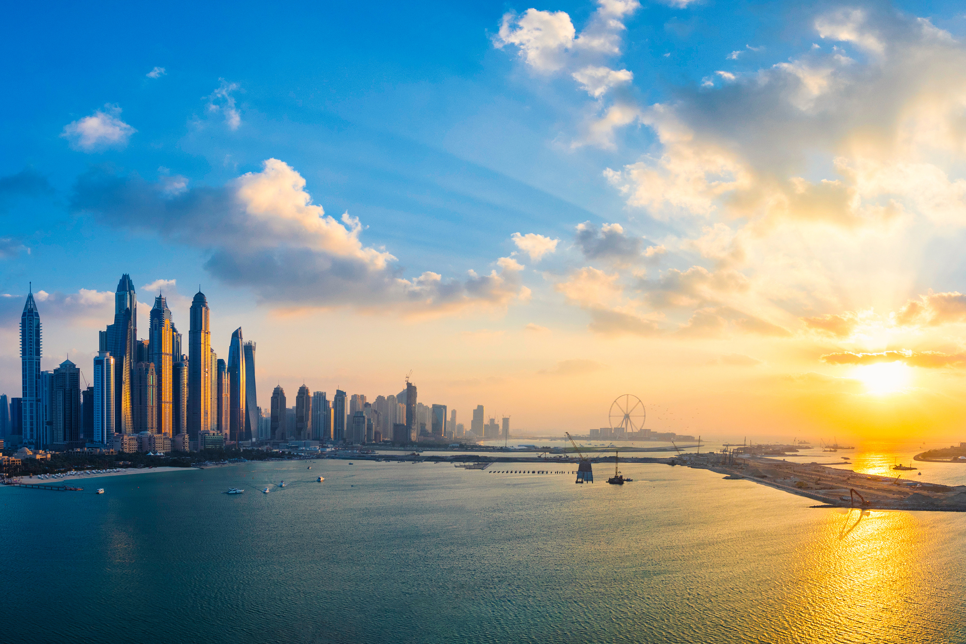
THANK
YOU
brazilbangladeshchamber.com

